Slide 1
Procedure & Function
Chapters 8 and 9

Slide 2
Differences Between Anonymous Blocks and Subprograms
Anonymous Blocks | Subprograms
Unnamed PL/SQL blocks | Named PL/SQL blocks
Compiled on every execution | Compiled only once, when created
Not stored in the database | Stored in the database
Cannot be invoked by other applications | They are named and therefore can be invoked by other applications
Do not return values | Subprograms called functions must return values
Cannot take parameters | Can take parameters
Keyword DECLARE | Keyword CREATE IS| AS

Slide 3
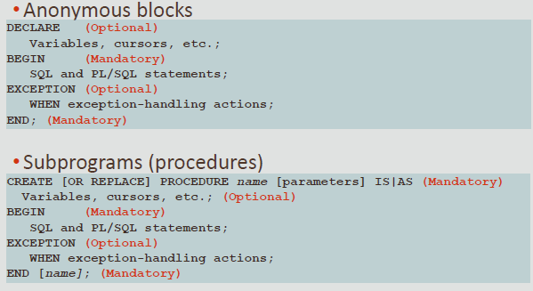
Differences Between Anonymous Blocks and Subprograms

Slide 4
Two types of Subprogram
Procedure Subprogram
Function Subprogram

Slide 5
Benefits of Subprograms
Easy maintenance
Code reuse
Improved data security
Many users can share a single copy of the subprogram code in memory

Slide 6
Procedures and Functions : Similarities
Are named PL/SQL blocks
Are called PL/SQL subprograms
Have block structures similar to anonymous blocks: Optional parameters
Optional declarative section (but the DECLARE keyword changes to IS or AS)
Mandatory executable section
Optional section to handle exceptions
Procedures and functions can both return data as OUT and IN OUT parameters

Slide 7
Procedures and Functions : Differences
A function MUST return a value using the RETURN statement
A procedure can only return a value using an OUT or an IN OUT parameter
The return statement in a function returns control to the calling program and returns the results of the function
The return statement within a procedure is optional
It returns control to the calling program before all of the procedure's code has been executed
Functions can be called from SQL, procedures cannot
Functions are considered expressions, procedures are not

Slide 8
What Is a Procedure?
A procedure is a named PL/SQL block that can accept parameters
Generally, you use a procedure to perform an action (sometimes called a “side-effect”)
A stored Procedure is a self-contained subprogram that is meant to do some specific tasks.
Also similar to function, procedures are named PL/SQL blocks thus they can be resued because they are stored into the database as an object.
Unlike PL/SQL Function a stored procedure does not return any value.

Slide 9
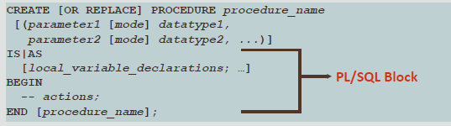
Procedure Syntax
Use CREATE PROCEDURE followed by the name, optional parameters, and keyword IS or AS
Add the OR REPLACE option to overwrite an existing procedure
Datatype can be either explicit (for example, VARCHAR2) or implicit with %TYPE
Body is the same as an anonymous block

Slide 10
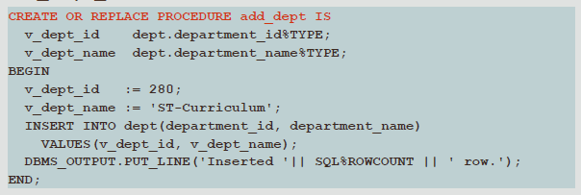
Procedure: Example without Parameters

Slide 11
Call Procedure
Calling Procedure using PL/SQL Statement
BEGIN
add_dept;
END;

Slide 12
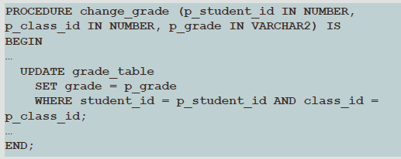
What Are Parameters?
Parameters pass or communicate data between the caller and the subprogram

Slide 13
Procedure: Example with Parameters
CREATE OR REPLACE PROCEDURE raise_salary
(p_id IN employees.employee_id%TYPE, p_percent IN NUMBER)
IS
BEGIN
UPDATE employees
SET salary = salary * (1 + p_percent/100)
WHERE employee_id= p_id;
END raise_salary;
Calling Procedure can be done by writing the following code
BEGIN raise_salary (176, 10);
END;

Slide 14
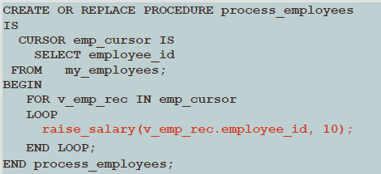
Procedure: Example with Cursor

Slide 15
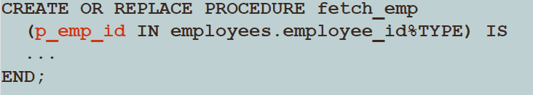
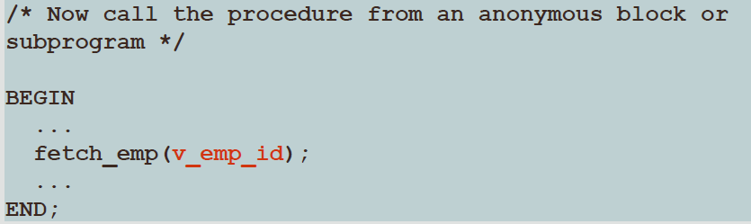
Types of Parameters
There are two types of parameters: Formal and Actual
A parameter-name declared in the procedure heading is called a formal parameter
The corresponding parameter-name (or value) in the calling environment is called an actual parameter

Slide 16
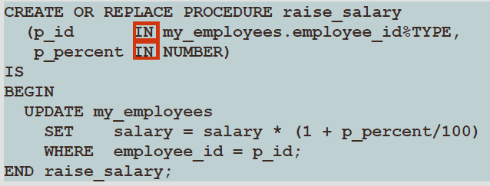
Default Mode :Parameter with IN
The IN mode is the default if no mode is specified
IN parameters can only be read within the procedure
They cannot be modified

Slide 17
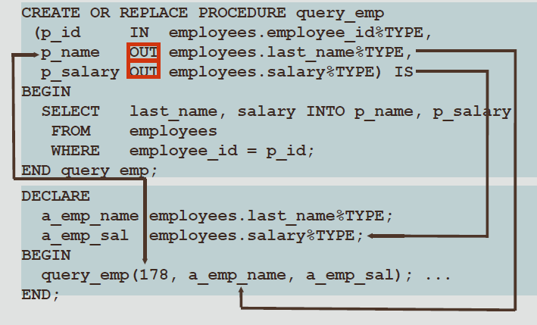
Using OUT Parameters
Create a procedure with OUT parameters to retrieve information about for example an employee.
OUT parameters that return values to the calling environment, shown in the code box

Slide 18
How To Use "IN OUT" Parameter Properly?
Here are the rules about IN OUT parameters:
A formal IN OUT parameter acts like an initialized variable.
An actual IN OUT parameter must be a variable.
An actual IN OUT parameter passes a copy of its value to the formal parameter when entering the procedure or function.
An actual IN OUT parameter will receive a copy of the value from the formal parameter at the end of the procedure or function.

Slide 19
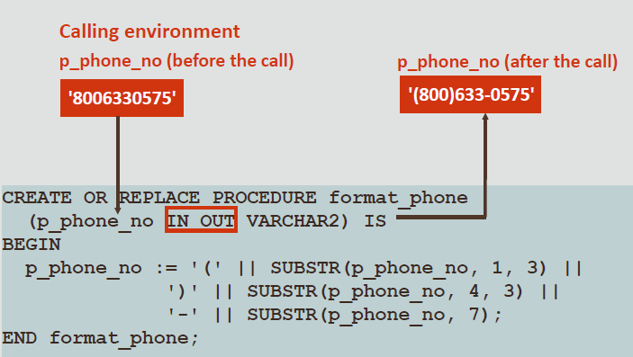
Using IN OUT Parameters: Example

Slide 20
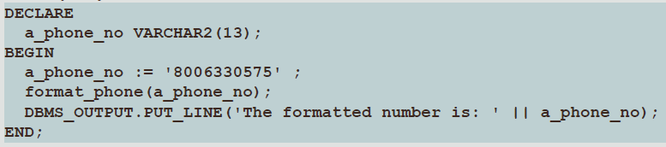
Calling

Slide 21
Using an IN OUT parameter, you can pass a value into a procedure that can be updated within the procedure
The actual parameter value supplied from the calling environment can return as either of the following:
The original unchanged value
A new value that is set within the procedure

Slide 22
Functions
In PL/SQL expressions, the function identifier acts like a variable whose value depends on the parameters passed to it
A function must have a RETURN clause in the header and at least one RETURN statement in the executable section

Slide 23
Syntax for Creating Functions
CREATE [OR REPLACE] FUNCTION function_name [(parameter1 [mode1]datatype1, ...)]
RETURN datatype IS|AS
[local_variable_declarations; …]
BEGIN--actions;
RETURN expression;
END [function_name];

Slide 24
Example
CREATE OR REPLACE FUNCTION get_sal
(p_id IN employees.employee_id%TYPE)
RETURN NUMBER IS
v_sal employees.salary%TYPE:= 0;
BEGIN
SELECT salary INTO v_sal
FROM employees WHERE employee_id= p_id;
RETURN v_sal;
EXCEPTION
WHEN NO_DATA_FOUND THEN RETURN NULL;
END get_sal;

Slide 25
Calling Function
DECLARE
v_sal employees.salary%type;
BEGIN
v_sal:= get_sal(100);
DBMS_OUTPUT.PUT_LINE(v_sal);
END;

Slide 26
Differences/Similarities Between Procedures and Functions
Procedures | Functions
Execute as a PL/SQL statement | Invoked as part of an expression
Do not contain RETURN clause in the header | Must contain a RETURN clause in the header
May return values (if any) in output parameters (not required) | Must return a single value
May contain a RETURN statement without a value | Must contain at least one RETURN statement

Slide 27
Question
Write a PL/SQL block to create a Function [FindEmpNo] to count all the number of employees in the employees table and return the total number of employees in calling section.
Write a PL/SQL block to create a Function [Findmultiplication] to multiple two numbers and return the result in number in calling section.

Slide 28
Answer
CREATE OR REPLACE FUNCTION totalEmployees
RETURN number IS
total number(2) := 0;
BEGIN
SELECT count(*) into total FROM employees;
RETURN total;
END;
Calling Function:
DECLARE
c number(2);
BEGIN
c := totalEmployees();
dbms_output.put_line('Total no. of employees: ' || c);
END;

